Slide 1


Efficient Personalized PageRank Computation: The Power of Variance-Reduced Monte Carlo Approaches
Meihao Liao¹, Rong-Hua Li¹, Qiangqiang Dai¹, Hongyang Chen², Hongchao Qin¹, Guoren Wang¹
Beijing Institute of Technology¹; Zhejiang Lab²
mhliao@bit.edu.cn; lironghuabit@126.com; qiangd66@gmail.com; dr.h.chen@ieee.org; qhc.neu@gmail.com; wanggrbit@126.com

Slide 2



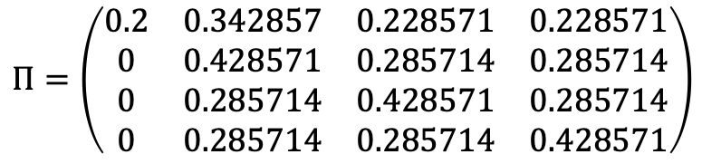
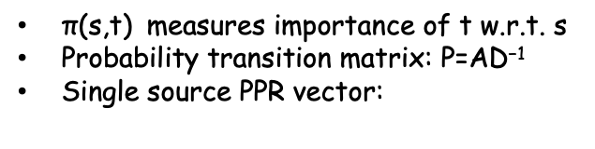

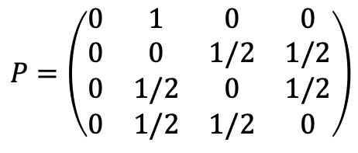



1. Problem Definition
Personalized PageRank
$$P=\left(\begin{matrix}0 & 1 & 0 & 0 \\ 0 & 0 & 1/2 & 1/2 \\ 0 & 1/2 & 0 & 1/2 \\ 0 & 1/2 & 1/2 & 0\end{matrix}\right)$$
$$v_{1}$$
$$v_{2}$$
$$v_{3}$$
$$v_{4}$$
$\text{π}\text{(}\text{s}\text{,}\text{t}\text{)}$ measures importance of t w.r.t. s
Probability transition matrix: $\text{P}\text{=}\text{AD}\text{−1}$
Single source PPR vector:
$$Π=\left(\begin{matrix}0.2 & 0.342857 & 0.228571 & 0.228571 \\ 0 & 0.428571 & 0.285714 & 0.285714 \\ 0 & 0.285714 & 0.428571 & 0.285714 \\ 0 & 0.285714 & 0.285714 & 0.428571\end{matrix}\right)$$
$$\text{Π}\text{ppr}\text{σ} \text{= }\text{α}{\text{(}\text{I}\text{−}\left(\text{1−}\text{α}\right)\text{P}\text{)}}^{\text{−1}}\text{σ}$$
$\text{Π}\text{ppr}\text{σ} \text{= }\text{α}\text{σ}\text{+}\text{α}$(1- $\text{α}$)P$\text{σ}$ + $\text{α}$(1- $\text{α}$)² P²$\text{σ}$+…
first step
second step
Personalized PageRank: $\text{σ}\text{=}{\text{e}}_{\text{s}}$
PageRank centrality: $\text{σ}\text{=}\frac{\text{1}}{\text{n}}$

Slide 3
1. Problem Definition
1
4
3
2
3
2
3
3
5
4
3
1
Existing Monte Carlo methods for approximating PPR:
7
5
7
6
5
4
6
6
7
5
$\text{α}$-random walk: at every step, stops with probability $\text{α}$
7
5
$\text{π}\text{(}\text{s}\text{,}\text{t}\text{)}$ : Pr(an $\text{α}$-random walk starts from s stops at t)
spanning forest: spanning forest generated by loop-erased$\text{α}$-random walk
$\text{π}\text{(}\text{s}\text{,}\text{t}\text{)}$ : Pr(s is rooted in t in a spanning forest)
Existing estimators suffer from a high variance…
higher variance more samples
longer time worse accuracy

Slide 4
1. Problem Definition
1
4
3
2
3
2
3
3
5
4
3
1
Existing Monte Carlo method for approximating PPR:
7
5
7
6
5
4
6
6
7
5
$\text{α}$-random walk: at every step, stops with probability $\text{α}$
7
5
$\text{π}\text{(}\text{s}\text{,}\text{t}\text{)}$ : Pr(an $\text{α}$-random walk starts from s stops at t)
spanning forest: spanning forest generated by loop-erased$\text{α}$-random walk
$\text{π}\text{(}\text{s}\text{,}\text{t}\text{)}$ : Pr(s is rooted in t in a spanning forest)
Existing estimators suffer from a high variance…
higher variance more samples
longer time worse accuracy
Several existing techniques for PPR computation can be regarded as techniques for reducing the variance of estimators
Push + random walk
“First propagate, then random walk”

Slide 5
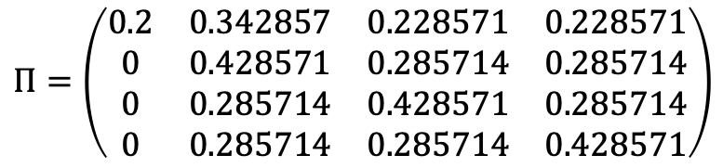
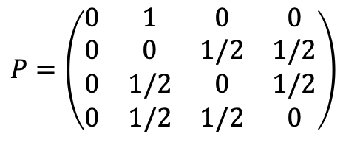
2. Our solutions
Variance reduction technique I: power method
Given a graph G,
$$v_{1}$$
$$v_{2}$$
$$v_{3}$$
$$v_{4}$$
The probability transition matrix
and PageRank matrix of G,
$$P=\left(\begin{matrix}0 & 1 & 0 & 0 \\ 0 & 0 & 1/2 & 1/2 \\ 0 & 1/2 & 0 & 1/2 \\ 0 & 1/2 & 1/2 & 0\end{matrix}\right)$$
$$Π=\left(\begin{matrix}0.2 & 0.342857 & 0.228571 & 0.228571 \\ 0 & 0.428571 & 0.285714 & 0.285714 \\ 0 & 0.285714 & 0.428571 & 0.285714 \\ 0 & 0.285714 & 0.285714 & 0.428571\end{matrix}\right)$$

Slide 6




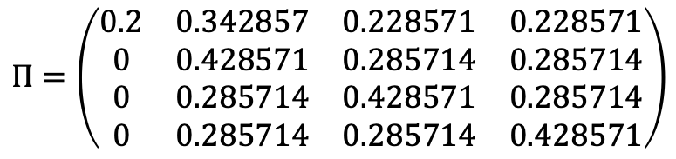




2. Our solutions
Variance reduction technique I: power method
Personalized PageRank vector with source node v1,
$$0.342857$$
$$0.2$$
$$v_{1}$$
$$v_{2}$$
$$v_{3}$$
$$0.228571$$
$$v_{4}$$
$$0.228571$$
$$Π=\left(\begin{matrix}0.2 & 0.342857 & 0.228571 & 0.228571 \\ 0 & 0.428571 & 0.285714 & 0.285714 \\ 0 & 0.285714 & 0.428571 & 0.285714 \\ 0 & 0.285714 & 0.285714 & 0.428571\end{matrix}\right)$$

Slide 7



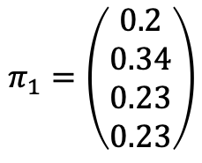





2. Our solutions
Variance reduction technique I: power method
$$0.342857$$
$$0.2$$
$$v_{1}$$
$$v_{2}$$
$$v_{3}$$
$$0.228571$$
$$π_{1}=\left(\begin{matrix}0.2 \\ 0.34 \\ 0.23 \\ 0.23\end{matrix}\right)$$
$$v_{4}$$
$$0.228571$$
To estimate the personalized PageRank vector,

Slide 8









2. Our solutions
Variance reduction technique I: power method
$$1$$
$$0$$
$$v_{1}$$
$$v_{2}$$
$$v_{3}$$
$$0$$
$$\overline{x}$$
$$v_{4}$$
$$0$$
Sample an $α$-random walk from v1, suppose it stops at v2, add v2 by 1

Slide 9









2. Our solutions
Variance reduction technique I: power method
$$1$$
$$0$$
$$0$$
$$v_{1}$$
$$v_{2}$$
$$v_{3}$$
$$0$$
$$0.2$$
$$v_{1}$$
$$v_{2}$$
$$v_{3}$$
$$0.4$$
$$\overline{x}$$
$$v_{4}$$
$${\overline{x}}^{\left\langle 1\right\rangle }$$
$$v_{4}$$
$$0$$
$$0.4$$
Sample an $α$-random walk from v1, suppose it stops at v2, add v2 by 1
Instead of adding v2 by 1,
Add v1 by $α$, add the neighbors of v2 by (1- $α$)/d_2

Slide 10
2. Our solutions
Variance reduction technique I: power method
The unbiasedness of the estimator can be guaranteed
Compared to existing framework “first propagate, then walk”,
we propose a new framework “first walk, then propagate”

Slide 11


























2. Our solutions
Variance reduction technique I: power method
$$1$$
$$0$$
$$0.48$$
$$0$$
$$v_{1}$$
$$v_{2}$$
$$v_{3}$$
$$0$$
$$0.2$$
$$v_{1}$$
$$v_{2}$$
$$v_{3}$$
$$0.4$$
$$0.2$$
$$v_{1}$$
$$v_{2}$$
$$v_{3}$$
$$0.16$$
$$\overline{x}$$
$$v_{4}$$
$${\overline{x}}^{\left\langle 1\right\rangle }$$
$$v_{4}$$
$${\overline{x}}^{\left\langle 2\right\rangle }$$
$$v_{4}$$
$$0$$
$$0.4$$
$$0.16$$
Apply for many
times
$$0.288$$
$$0.3648$$
$$0.2$$
$$v_{1}$$
$$v_{2}$$
$$v_{3}$$
$$0.256$$
$$0.2$$
$$v_{1}$$
$$v_{2}$$
$$v_{3}$$
$$0.2176$$
$${\overline{x}}^{\left\langle 3\right\rangle }$$
$$v_{4}$$
$${\overline{x}}^{\left\langle 4\right\rangle }$$
$$v_{4}$$
$$0.256$$
$$0.2176$$

Slide 12
2. Our solutions
Variance reduction technique I: power method
$$1$$
$$0$$
$$0.48$$
$$0$$
$$v_{1}$$
$$v_{2}$$
$$v_{3}$$
$$0$$
$$0.2$$
$$v_{1}$$
$$v_{2}$$
$$v_{3}$$
$$0.4$$
$$0.2$$
$$v_{1}$$
$$v_{2}$$
$$v_{3}$$
$$0.16$$
$$\overline{x}$$
$$v_{4}$$
$${\overline{x}}^{\left\langle 1\right\rangle }$$
$$v_{4}$$
$${\overline{x}}^{\left\langle 2\right\rangle }$$
$$v_{4}$$
$$0$$
$$0.4$$
$$0.16$$
$$0.288$$
$$0.3648$$
Apply for many
times
$$0.2$$
$$v_{1}$$
$$v_{2}$$
$$v_{3}$$
$$0.256$$
$$0.2$$
$$v_{1}$$
$$v_{2}$$
$$v_{3}$$
$$0.2176$$
$${\overline{x}}^{\left\langle 3\right\rangle }$$
$$v_{4}$$
$${\overline{x}}^{\left\langle 4\right\rangle }$$
$$v_{4}$$
The variance
will drop exponentially!
$$0.256$$
$$0.2176$$

Slide 13




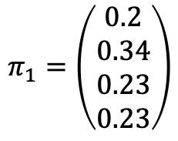

2. Our solutions
Variance reduction technique II: progressive sampling
$$0.342857$$
$$0.2$$
$$v_{1}$$
$$v_{2}$$
$$v_{3}$$
$$0.228571$$
$$π_{1}=\left(\begin{matrix}0.2 \\ 0.34 \\ 0.23 \\ 0.23\end{matrix}\right)$$
$$v_{4}$$
$$0.228571$$
To approximate the personalized PageRank vector,
We have obtained a current solution,

Slide 14
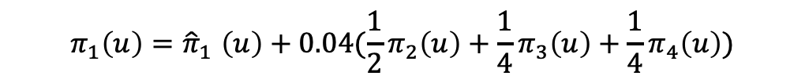
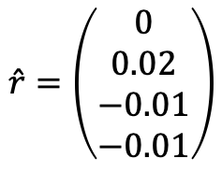








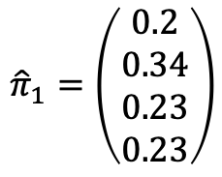
2. Our solutions
Variance reduction technique II: progressive sampling
$$0.34$$
$$0.2$$
$$v_{1}$$
$$v_{2}$$
$$v_{3}$$
$$0.23$$
$${\hat{π}}_{1}=\left(\begin{matrix}0.2 \\ 0.34 \\ 0.23 \\ 0.23\end{matrix}\right)$$
$$\hat{r}=\left(\begin{matrix}0 \\ 0.02 \\ −0.01 \\ −0.01\end{matrix}\right)$$
$${\hat{π}}_{1}$$
$$v_{4}$$
$$0.23$$
$$π_{1}\left(u\right){=\hat{π}}_{1}\left(u\right)+0.04(\frac{1}{2}π_{2}\left(u\right)+\frac{1}{4}π_{3}\left(u\right)+\frac{1}{4}π_{4}\left(u\right))$$
We have obtained a current solution,
Compute the residual vector r=b-Ax,
We can further sample $α$-random walks from v2, v3, v4

Slide 15
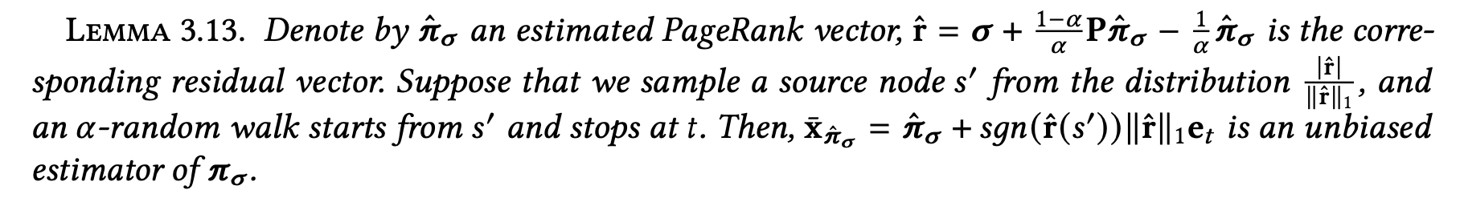
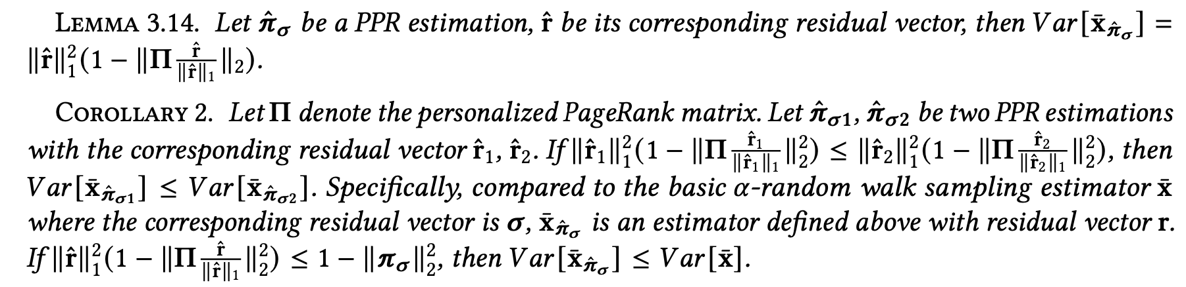
2. Our solutions
Variance reduction technique II: progressive sampling

Slide 16
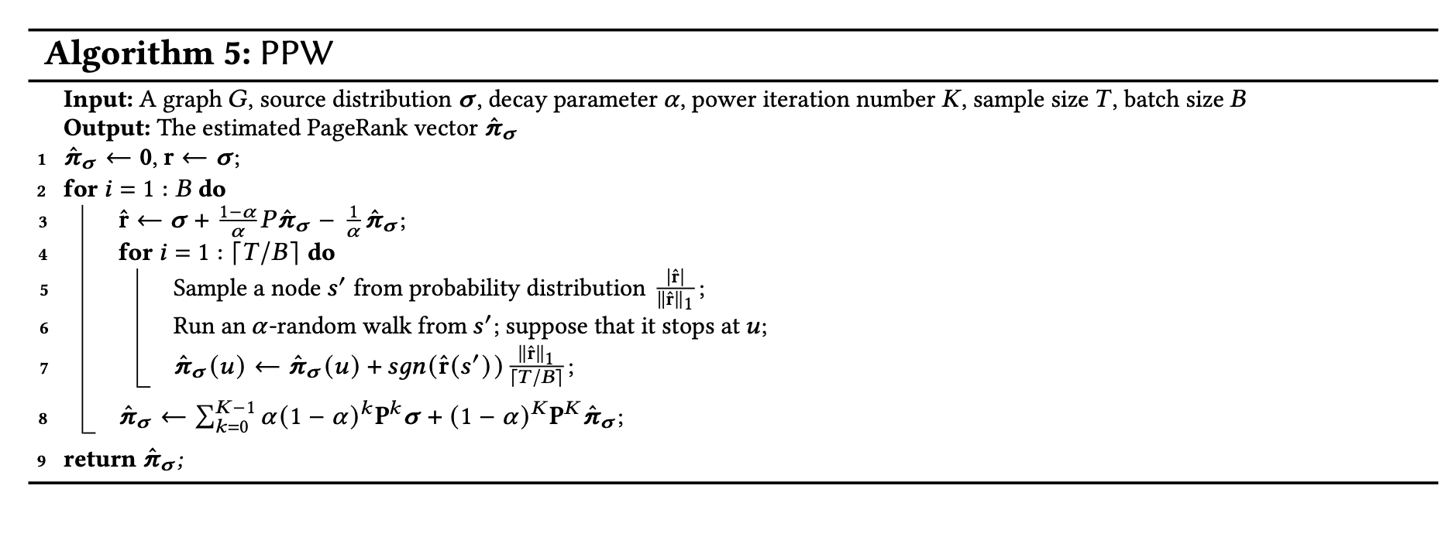

2. Our solutions
The resulting algorithms
We apply the two variance reduction techniques on two estimators:
$α$-random walk sampling based estimators
Spanning forests sampling based estimators

Slide 17
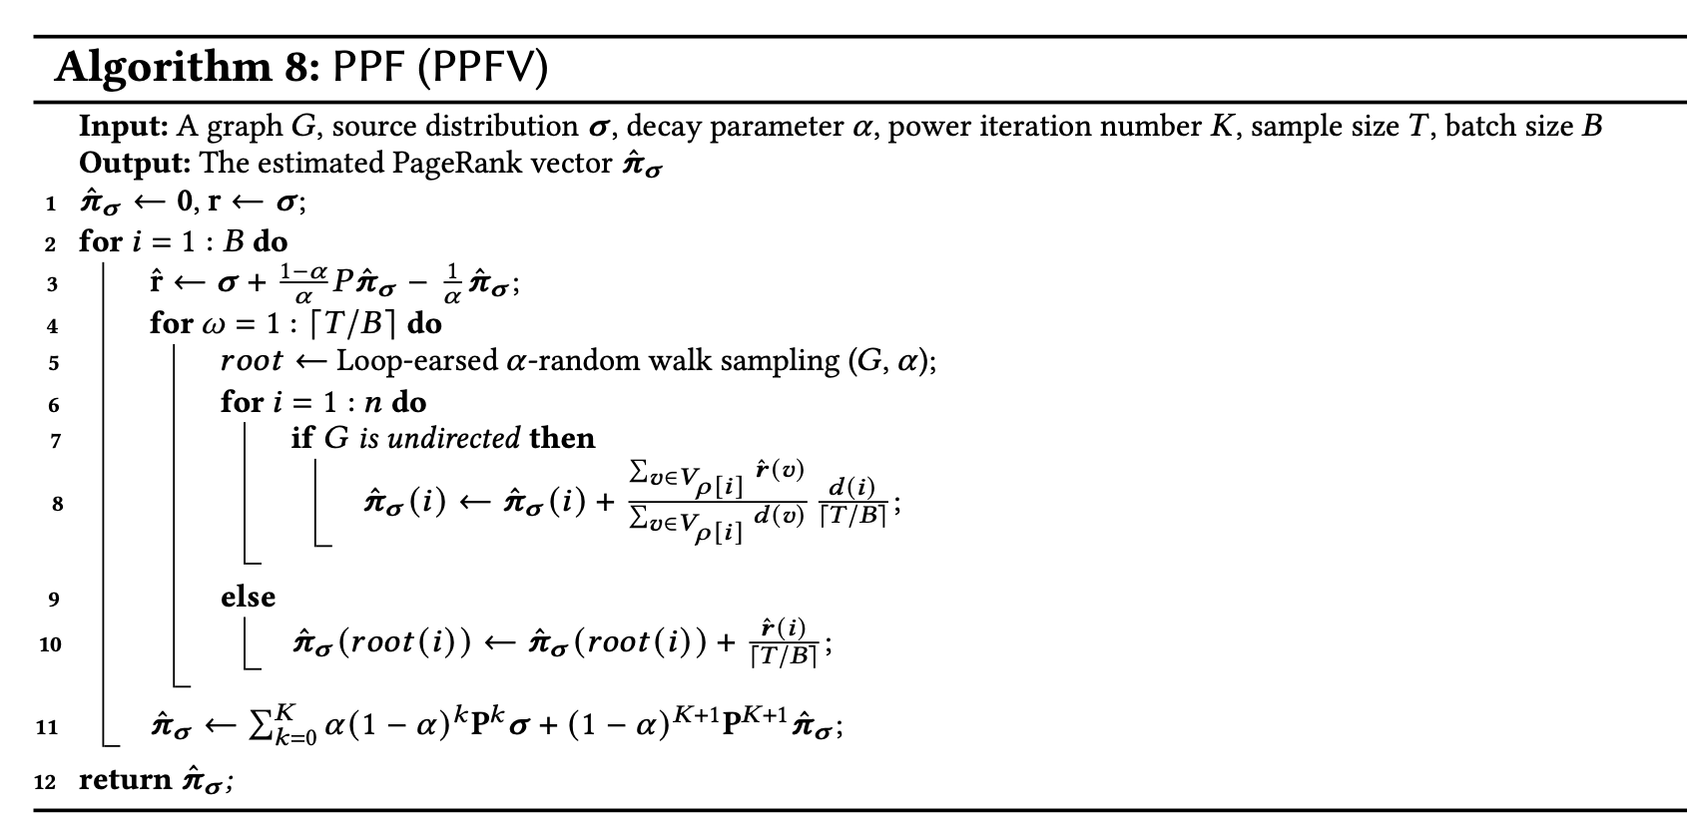

2. Our solutions
The resulting algorithms
We use the two variance reduction techniques on two estimators:
$α$-random walk sampling based estimators
Spanning forests sampling based estimators

Slide 18
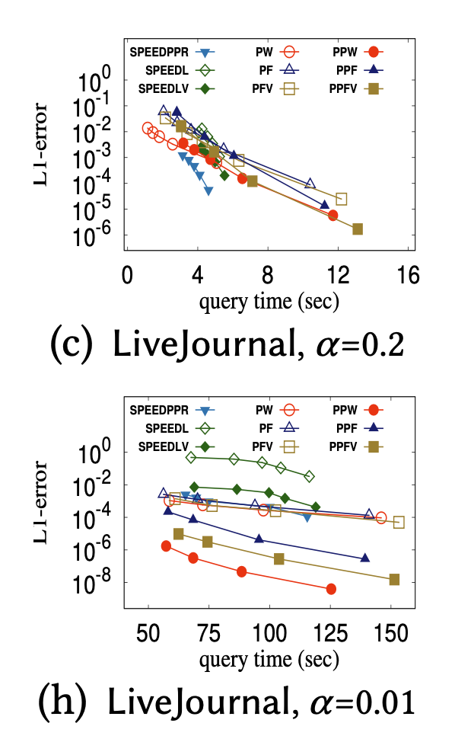

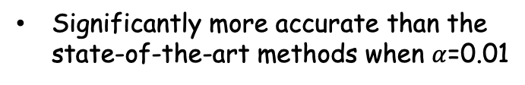
3. Experimental Results
Single source
Source vector is e_s
Competitive with the state-of-the-art methods when $α$=0.2
Significantly more accurate than the state-of-the-art methods when $α$=0.01

Slide 19
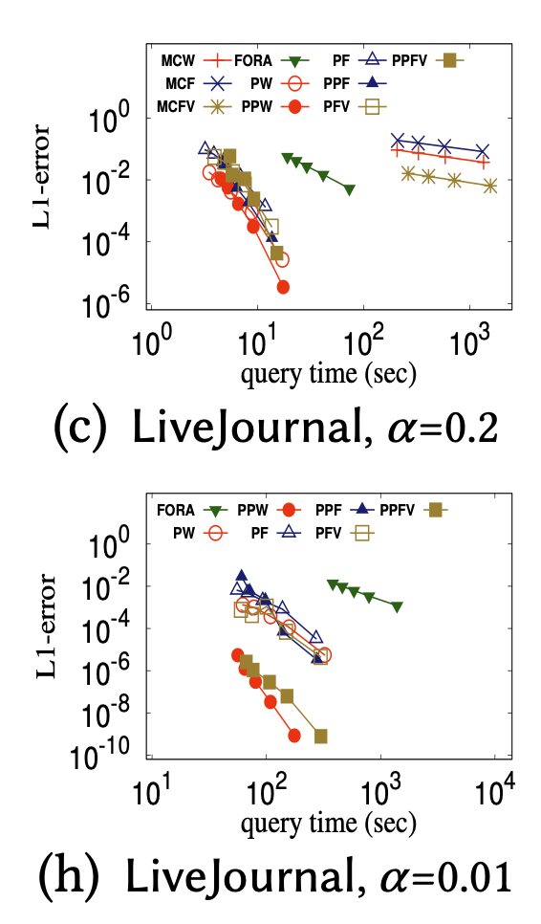
3. Experimental Results
PageRank centrality:
Source vector is 1/n
Faster and more accurate than the state-of-the-art methods

Slide 20
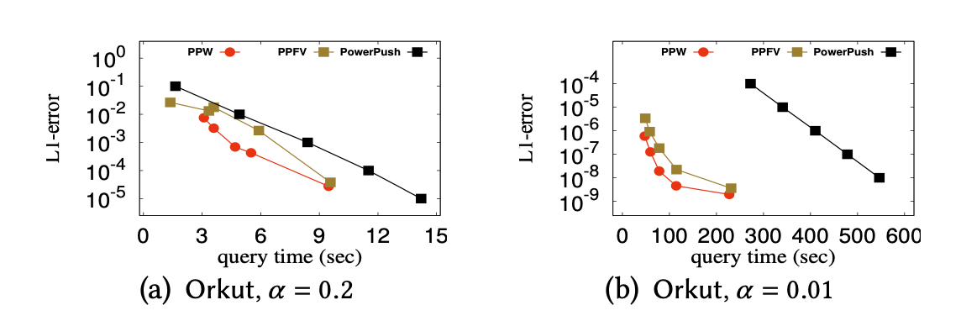
3. Experimental Results
Compare with high precision algorithms
Also better than the state-of-the-art high-precision methods

Slide 21
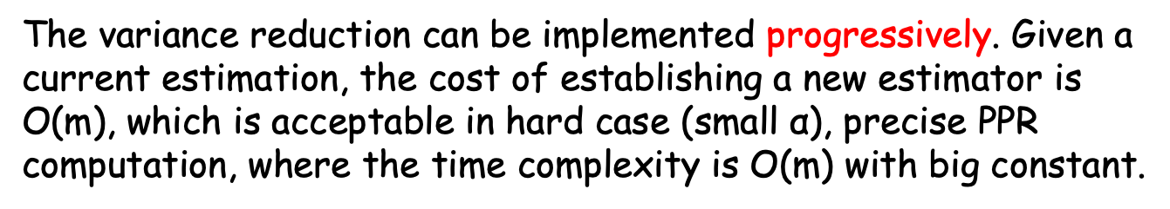
Take Home Message
Two new techniques to reduce the variance of PPR estimators are proposed, we can follow the “first walk, then propagate” framework, with similar performance to existing solutions!
The variance reduction can be implemented progressively. Given a current estimation, the cost of establishing a new estimator is O(m), which is acceptable in hard case (small $\text{α}$), precise PPR computation, where the time complexity is O(m) with big constant.

Slide 22
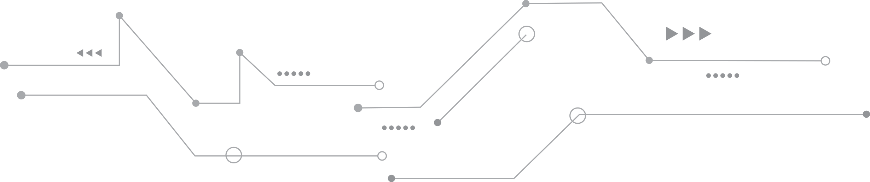
THANKS

